Slide 1

UNIVERSITY OF LUCKNOW,LUCKNOW FACULTY OF ENGINEERING & TECHNOLOGY
ADVANCE DBMS
CS-751
Hospital Management System
SUBMITTED TO :
Dr. Jasvant Singh
SUBMITTED BY :
Ankur Pal (200013139137)
Ashish Kumar (200013139138)

Slide 2
Why is HMS important for a hospital?
HMS was introduced to solve the complications coming from managing all the paper works of every patient associated with the various departments of hospitalization with confidentiality
. HMS provides the ability to manage all the paperwork in one place, reducing the work of staff in arranging and analyzing the paperwork of the patients.
HMS does many works like:
Maintain the medical records of the patient
Maintain the contact details of the patient
Keep track of the appointment dates
Save the insurance information for later reference
Tracking the bill payments.

Slide 3

OBJECTIVE OF THIS PROJECT
The Hospital Management System (HMS) is software that is designed to handle all the activities of clinic workflow like registration, appointment, administrative, list of Dr. and services provided by hospital.
It also converts all paper works into digital form.

Slide 4
The Role of HMS in the Healthcare Sector
Hospitals faced many complications of paper works. Improper documentation of patient data across various departments is a confidential matter.
However, the hospital Management system automates the management and reduces the paperwork. Thus, it not only reduces the burden on staff but also makes documentation easier.

Slide 5
Advantages
:
Digital medical records reduce the errors
Improves efficiency of the staff
Manages hospital facilities efficiently
Reduces the time-consumption
Cost-effective and helps in tax planning
Catalyst in achieving quality ratings
Enhanced patient care

Slide 6
Features of the Software
Hospital Management System is an automated and integrated software for all your hospital needs. It is developed in accordance with the World Health Organisation Standards.
It is aimed to record each and every transaction of your hospital and preserve securely.
It establishes the paper less office and transmit the data with in the departments.
Comprehensive Performance Reports.
Graphical Presentation of the Data for Top Management for analysis.

Slide 7
Main Modules
Registration
Appointment
List of Doctors
Services available
Modify data
Exit

Slide 8
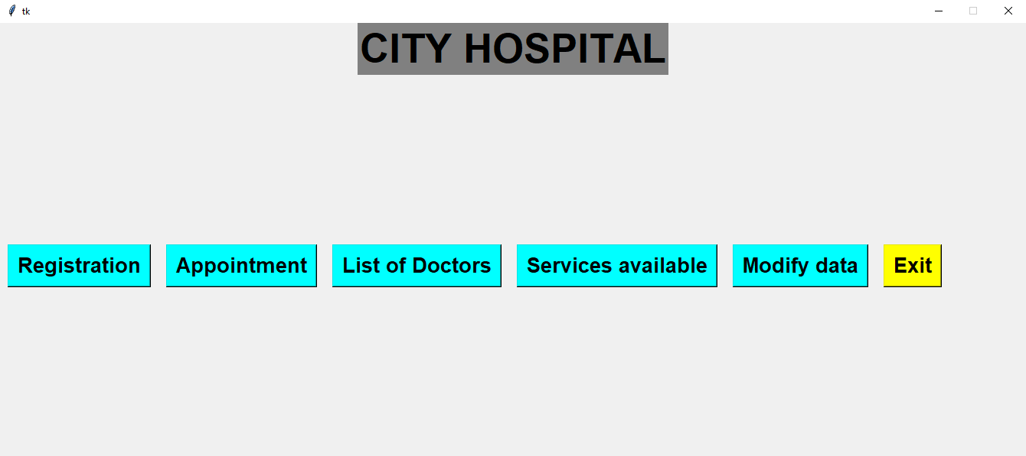
Hospital Management

Slide 9
Registration Module
Patient id
Name
Age
gender M/F
Phone
Blood Group

Slide 10
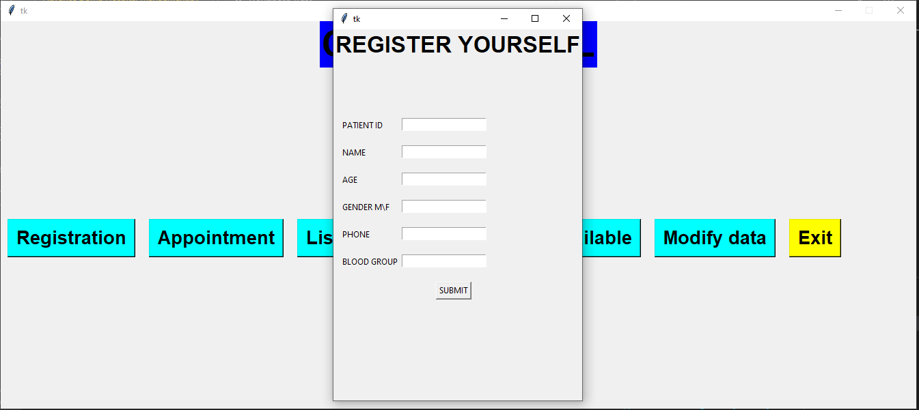
Registration

Slide 11
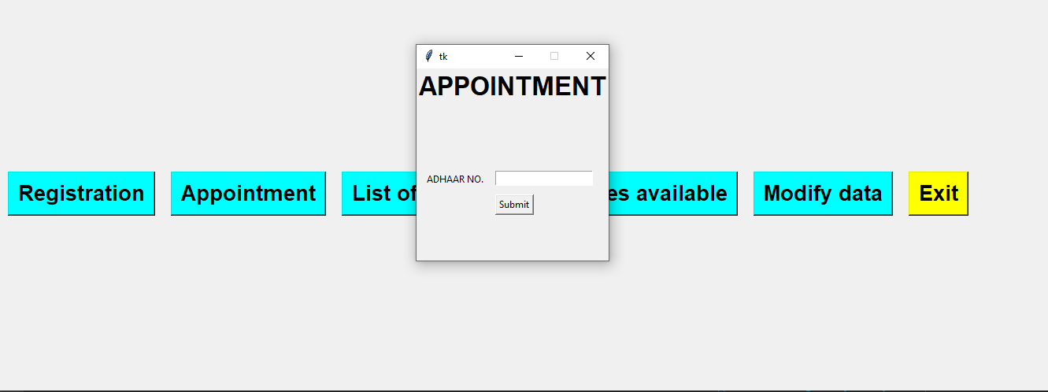
Appointment
With an appointment system, the non-urgent patients can schedule their consultation in advance. As this eliminates wait times upon arrival, it has a significant impact on the patient experience

Slide 12
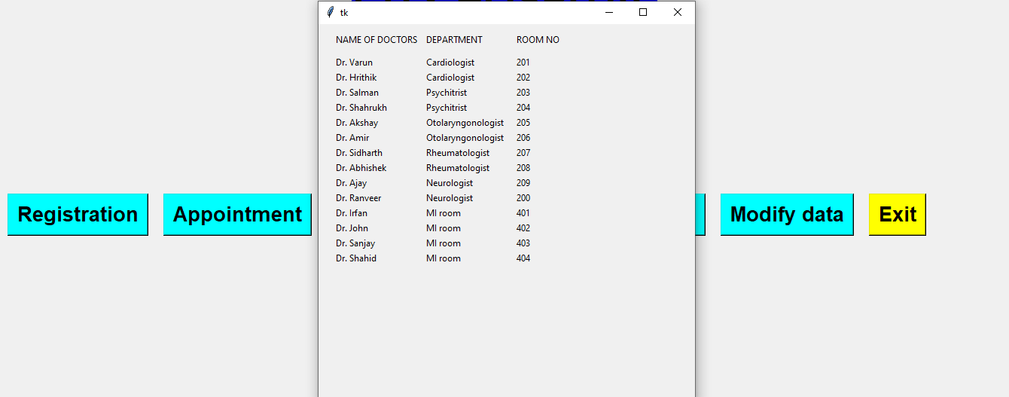
List of Doctors

Slide 13
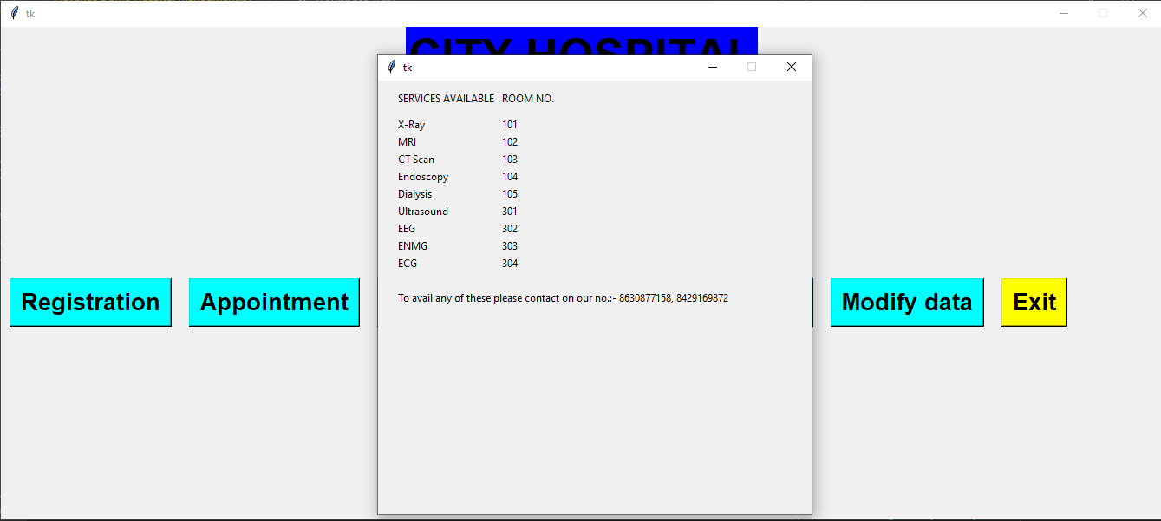
Services Available

Slide 14
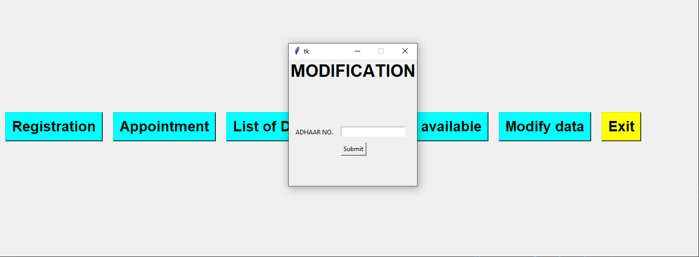
Modify Data

Slide 15
Thank You
Project By :- Ankur Pal, Ashish Kumar

